Slide 1

Deep Learning with Python Training and Evaluation
Edgar Lobaton, Ph.D.
Electrical & Computer Engr. Dept.
North Carolina State University

Slide 2
Agenda
Model Selection and Evaluation
Loss Function
Gradient Descent
Backpropagation
Challenges
Presentation Title

Slide 3
Model Selection and Evaluation

Slide 4












Model Selection and Evaluation
Given a training set $X_{T}={\left\{x_{i}\right\}}_{i=1}^{N}$ and $Y_{T}={\left\{y_{i}\right\}}_{i=1}^{N}$, a predictor $f^{∗}(x)$ fitted to the data, and a loss function $L(⋅,⋅)$, we have defined the pipeline:
Besides using loss functions for training of a model and testing (i.e., Evaluation), they can also be used for Model Selection when we have hyper-parameters.
Training
Prediction
$$X_{T}$$
$$X$$
$$f^{∗}$$
$$f^{∗}$$
$$\hat{Y}$$
Model
Model
$$Y_{T}$$
$$Loss$$
$$Y$$
$Loss$ / $Metric$
$$E_{T}$$
$$E_{G}$$

Slide 5
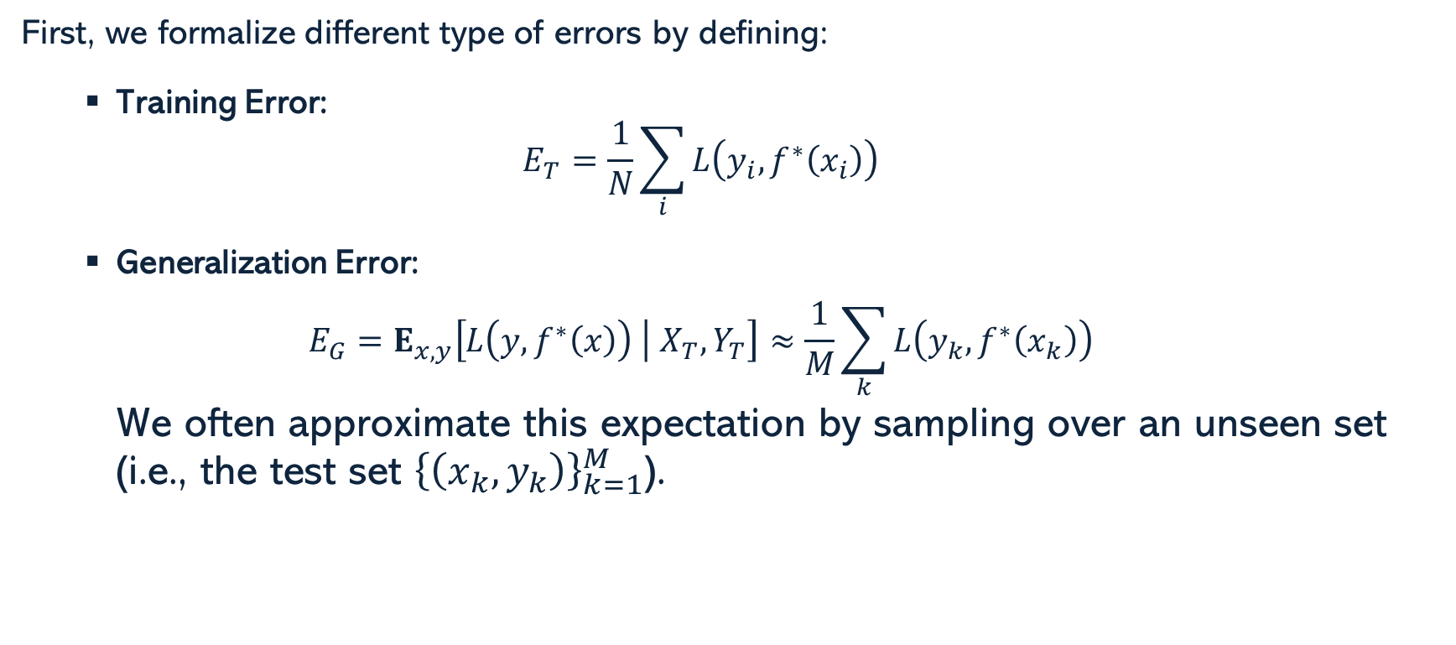
Generalization Error
First, we formalize different type of errors by defining:
Training Error:
$$E_{T}=\frac{1}{N}\sum_{i}{L\left(y_{i},f^{∗}\left(x_{i}\right)\right)}$$
Generalization Error:
$$E_{G}=E_{x,y}\left[L\left(y,f^{∗}\left(x\right)\right) | X_{T},Y_{T}\right]≈\frac{1}{M}\sum_{k}{L\left(y_{k},f^{∗}\left(x_{k}\right)\right)}$$
We often approximate this expectation by sampling over an unseen set (i.e., the test set ${\left\{\left(x_{k},y_{k}\right)\right\}}_{k=1}^{M}$).

Slide 6
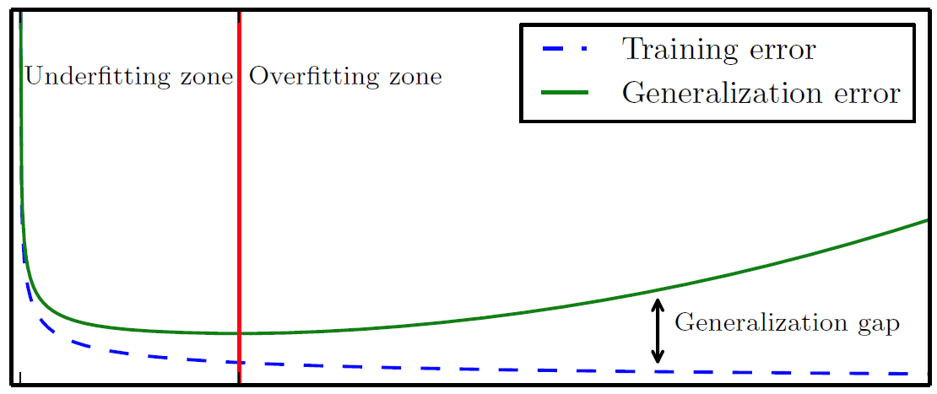
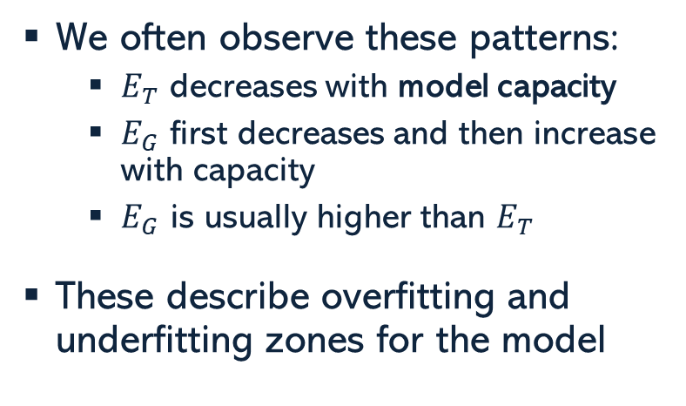
Overfitting vs. Underfitting
We often observe these patterns:
$E_{T}$ decreases with model capacity
$E_{G}$ first decreases and then increase with capacity
$E_{G}$ is usually higher than $E_{T}$
These describe overfitting and underfitting zones for the model
Training Error
Underfitting Zone
Overfitting Zone
Generalization Error
Error
Generalization Gap
Optimal Capacity
Model Capacity
One of the most common approaches to selecting an optimal capacity for a model is to use validation.

Slide 7
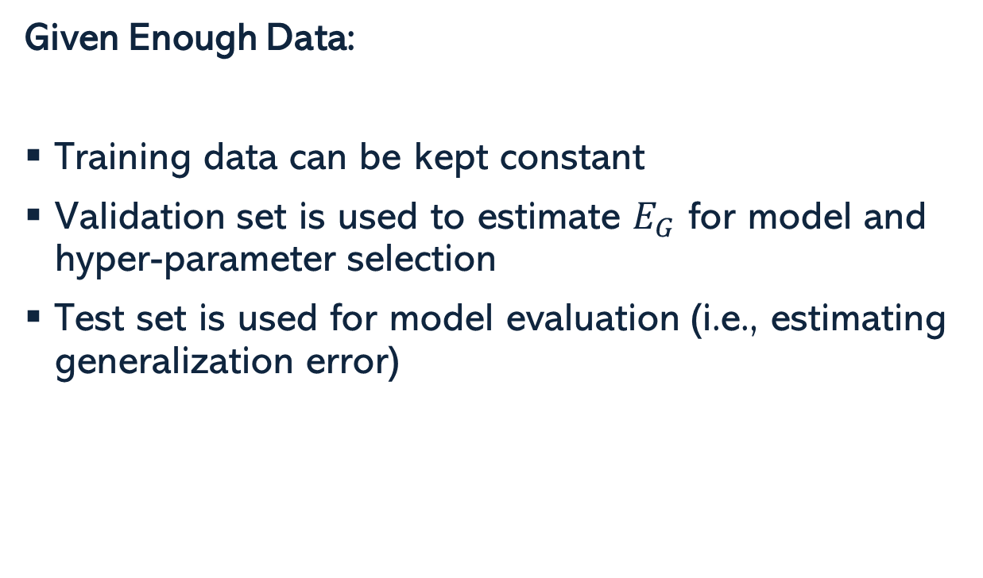
Validation
Given Enough Data:
Training data can be kept constant
Validation set is used to estimate $E_{G}$ for model and hyper-parameter selection
Test set is used for model evaluation (i.e., estimating generalization error)
Training – 85%
Pre-Val Training 70%
Validation
15%
Testing – 15%

Slide 8
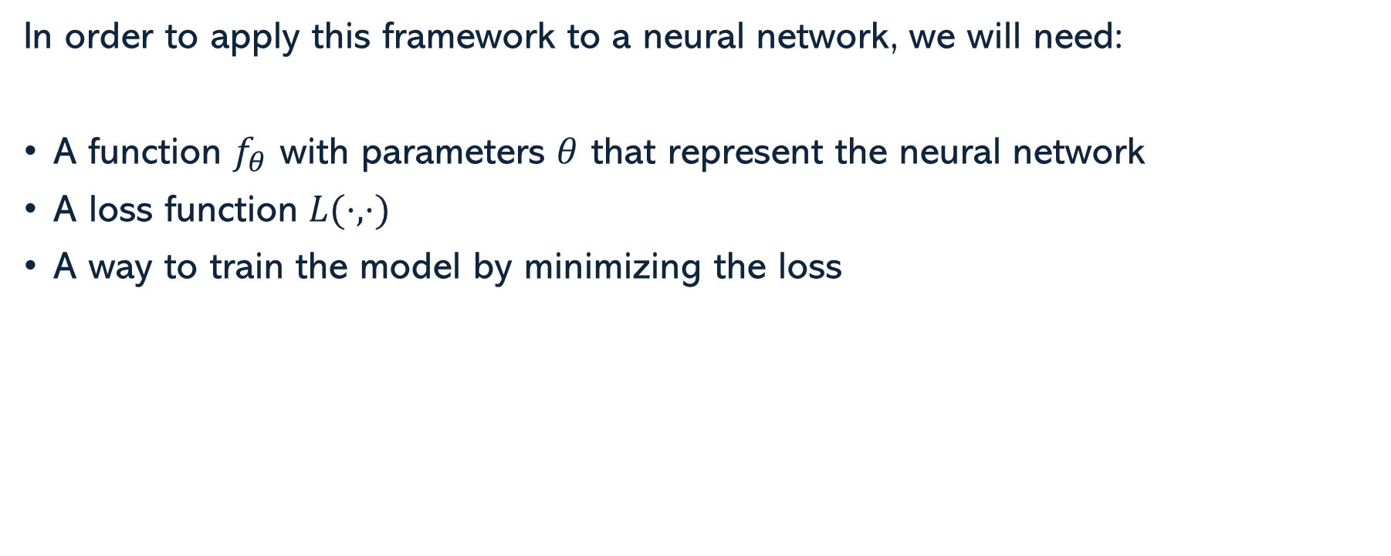
What do we need?
In order to apply this framework to a neural network, we will need:
A function $f_{θ}$ with parameters $θ$ that represent the neural network
A loss function $L(⋅,⋅)$
A way to train the model by minimizing the loss

Slide 9
Loss Function

Slide 10
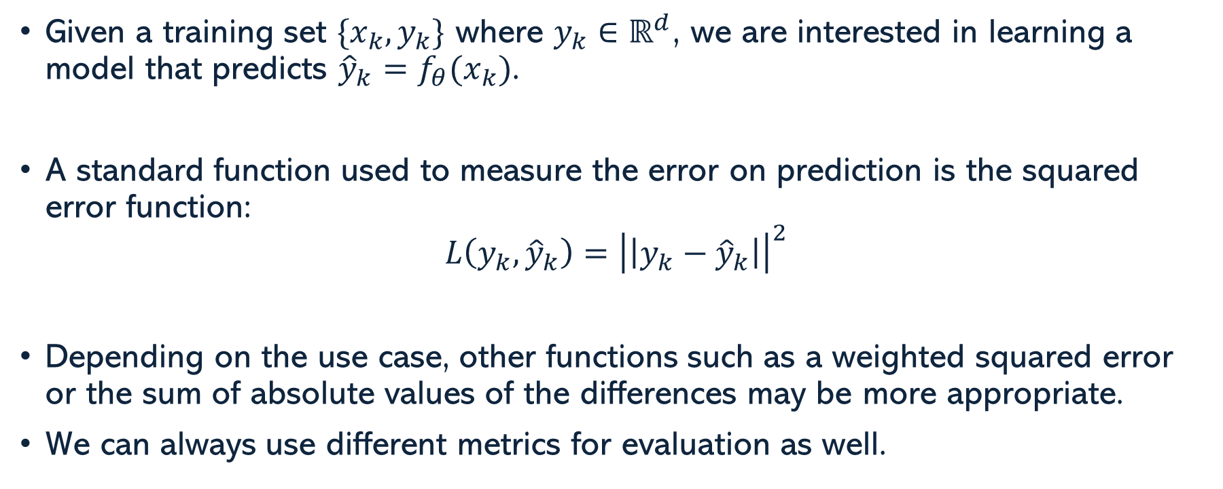
Regression Task
Given a training set $\{x_{k},y_{k}\}$ where $y_{k}∈ℝ^{d}$, we are interested in learning a model that predicts ${\hat{y}}_{k}=f_{θ}(x_{k})$.
A standard function used to measure the error on prediction is the squared error function:
$$L\left(y_{k},{\hat{y}}_{k}\right)={\left|\left|y_{k}−{\hat{y}}_{k}\right|\right|}^{2}$$
Depending on the use case, other functions such as a weighted squared error or the sum of absolute values of the differences may be more appropriate.
We can always use different metrics for evaluation as well.

Slide 11
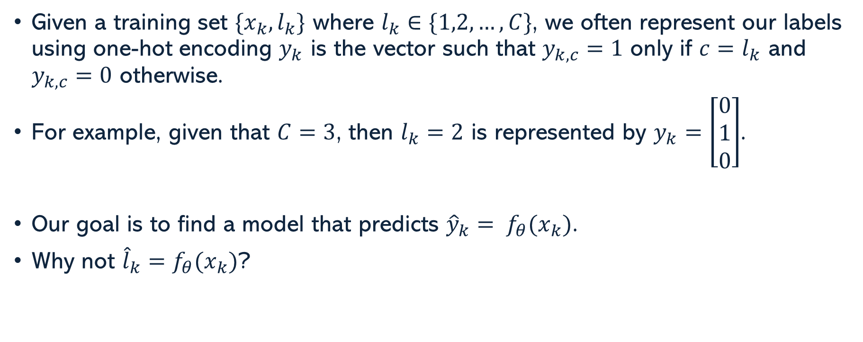
Classification Task
Given a training set $\{x_{k},l_{k}\}$ where $l_{k}∈\{1,2,…,C\}$, we often represent our labels using one-hot encoding $y_{k}$ is the vector such that $y_{k,c}=1$ only if $c=l_{k}$ and $y_{k,c}=0$ otherwise.
For example, given that $C=3$, then $l_{k}=2$ is represented by $y_{k}=\left[\begin{matrix}0 \\ 1 \\ 0\end{matrix}\right]$.
Our goal is to find a model that predicts ${\hat{y}}_{k}= f_{θ}(x_{k})$.
Why not ${\hat{l}}_{k}=f_{θ}(x_{k})$?

Slide 12
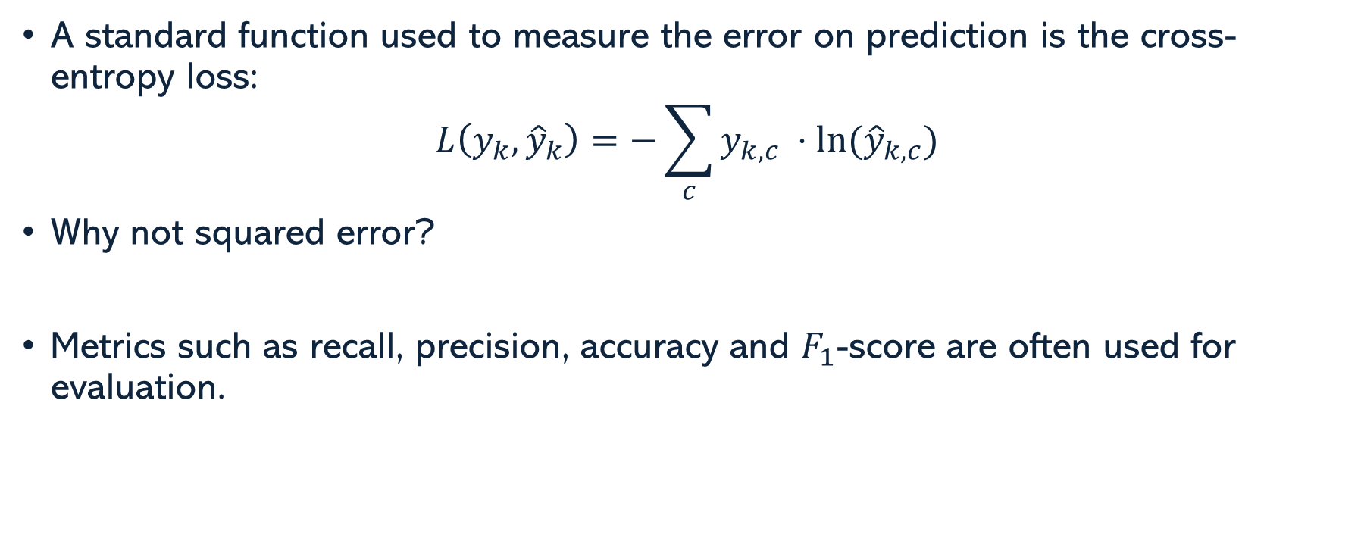
Classification Task
A standard function used to measure the error on prediction is the cross-entropy loss:
$$L\left(y_{k},{\hat{y}}_{k}\right)=−\sum_{c}{y_{k,c} ⋅ln⁡({\hat{y}}_{k,c})}$$
Why not squared error?
Metrics such as recall, precision, accuracy and $F_{1}$-score are often used for evaluation.

Slide 13
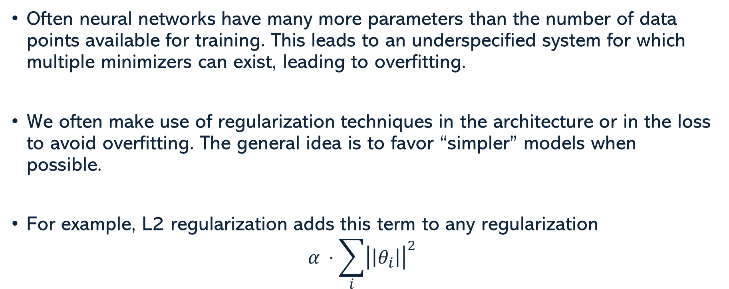
Regularization Terms
Often neural networks have many more parameters than the number of data points available for training. This leads to an underspecified system for which multiple minimizers can exist, leading to overfitting.
We often make use of regularization techniques in the architecture or in the loss to avoid overfitting. The general idea is to favor “simpler” models when possible.
For example, L2 regularization adds this term to any regularization
$$α ⋅\sum_{i}{{\left|\left|θ_{i}\right|\right|}^{2}}$$

Slide 14
Gradient Descent

Slide 15
Gradient Descent
$$C$$
A first order method uses the gradient to take a step of a given length on the direction that reduces the function.
Given a cost function (e.g., a loss) $C$ for a set of parameter $θ$, the update rule for first order methods is $θ^{(k+1)}=θ^{\left(k\right)}−ε⋅\frac{dC}{dθ}{\left(θ\right)}^{⊤}$, where $ε$ is referred to as the learning rate.
$$C(θ)$$
$$θ$$
$$θ^{(0)}$$
$$θ^{\left(1\right)}$$

Slide 16
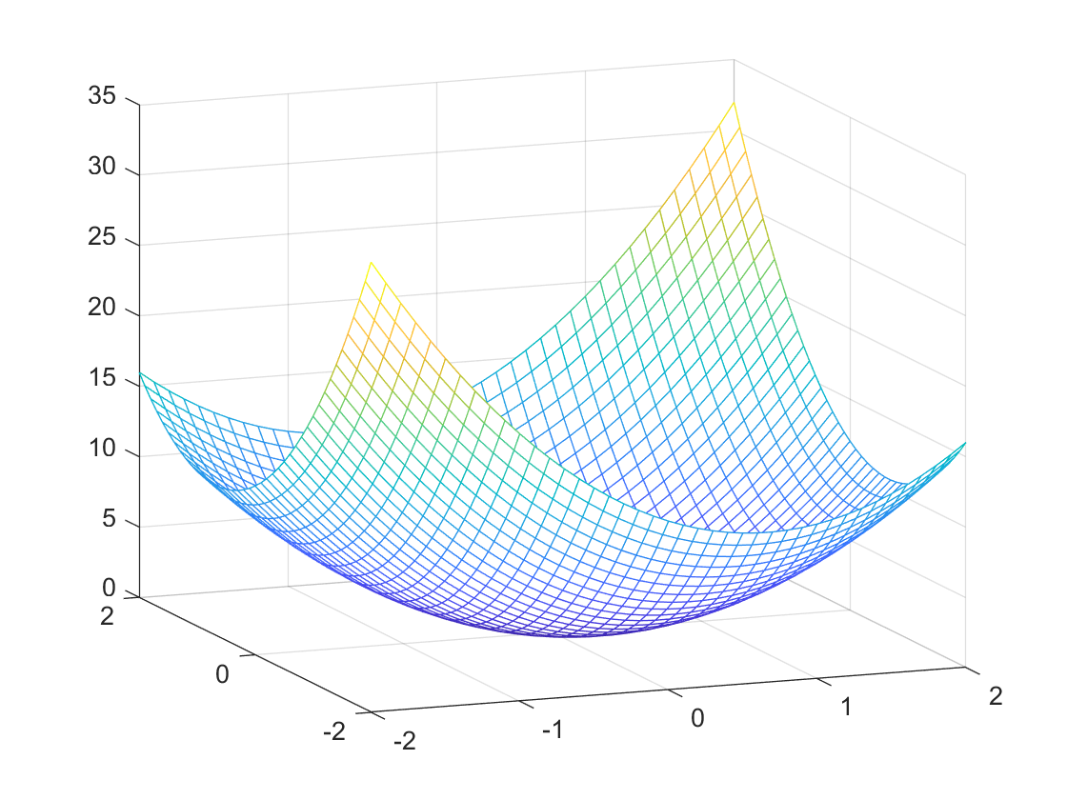
Gradient Descent
Function Minimization:
$ε$ too large
$ε$ about right
$$θ^{\left(1\right)}$$
$$θ^{\left(1\right)}$$
$$θ^{\left(2\right)}$$
$$θ^{\left(3\right)}$$
$$θ_{2}$$
$$θ^{\left(3\right)}$$
$$θ^{\left(0\right)}$$
$$θ^{\left(2\right)}$$
$$θ^{\left(0\right)}$$
$$−\frac{dC}{dθ}\left(θ^{\left(0\right)}\right)$$
$$θ_{2}$$
$$θ_{1}$$
$$θ_{1}$$

Slide 17
Stochastic Gradient Descent (SGD)
A Deep Neural Network’s large amount of data can be challenging to process
The basic approach using full data is referred to as Batch Gradient Descent
SGD uses Mini-Batches
Using a Mini-Batch provides a faster convergence
Randomized gradient has some benefits
$$θ^{\left(2\right)}$$
$$θ^{\left(3\right)}$$
$$θ^{\left(0\right)}$$
$$θ^{\left(1\right)}$$

Slide 18
Stochastic Gradient Descent (SGD)
Making a pass through the entire data using mini-batches is known as an epoch of training
Variants of SGD include:
SGD with Momentum
Adam Optimizer

Slide 19
Backpropagation

Slide 20
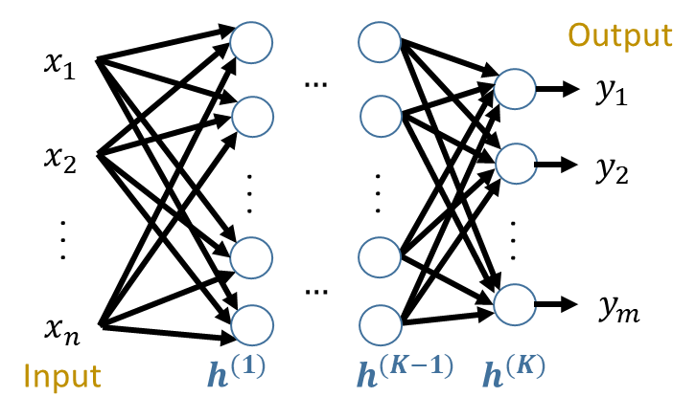
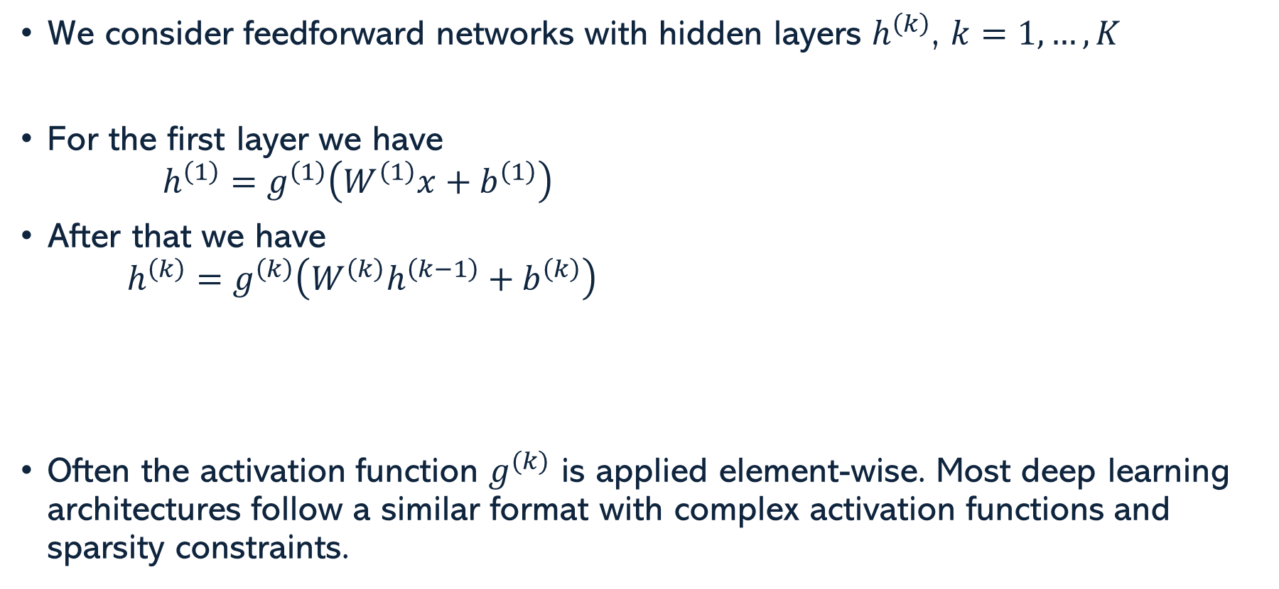
Neural Nets Architecture
We consider feedforward networks with hidden layers $h^{\left(k\right)}$, $k=1,…,K$
For the first layer we have
$$h^{\left(1\right)}=g^{\left(1\right)}\left(W^{\left(1\right)}x+b^{\left(1\right)}\right)$$
After that we have
$$h^{\left(k\right)}=g^{\left(k\right)}\left(W^{\left(k\right)}h^{\left(k−1\right)}+b^{\left(k\right)}\right)$$
Often the activation function $g^{(k)}$ is applied element-wise. Most deep learning architectures follow a similar format with complex activation functions and sparsity constraints.

Slide 21
Forward & Backpropagation
Forward propagation refers to the process of evaluating a neural network from input to output. This just requires standard evaluation of the functions defined at each neuron.
Backpropagation refers to the process of computing the derivatives of the loss function starting on the output and ending at the input. This is done in reverse order for computational efficiency.
Backpropagation results in the multiplication of partial derivatives using the chain rule.

Slide 22
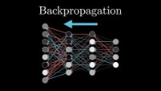
Backpropagation

Slide 23
Challenges

Slide 24
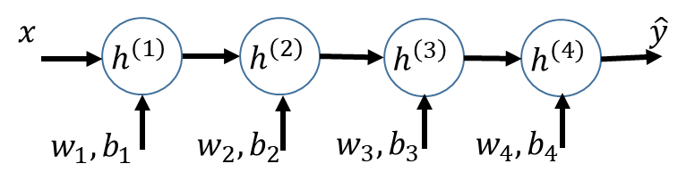
Vanishing / Exploding Gradients
ReLU
Consider a simple scalar network with
$$a^{\left(k\right)}=w_{k}⋅h^{\left(k−1\right)}+b_{k} ; h^{\left(k\right)}=g\left(a^{\left(k\right)}\right)$$
Initialize $w,b \sim N(0,1)$
Sigmoid
Then,
$$\frac{dL_{y}}{db_{1}}\left(w,b \right)=\frac{dL_{y}}{d\hat{y}}\left(h^{\left(4\right)}\right)⋅g^{′}\left(a^{\left(4\right)}\right)⋅w_{4}⋅g^{′}\left(a^{\left(3\right)}\right)⋅w_{3}⋅g^{′}\left(a^{\left(2\right)}\right)⋅w_{2}⋅g^{′}\left(a^{\left(1\right)}\right)$$
Notes:
The issue of vanishing gradients is caused by the derivatives of the sigmoid been small and mostly zero. ReLu reduces that effect. However, if the weights end up being large then we can have an exploiting gradient.

Slide 25




Thank you
Edgar Lobaton
edgar.lobaton@ncsu.edu
https://research.ece.ncsu.edu/aros/

